Slide 1
Challenges
Mini challenge 3

Slide 2
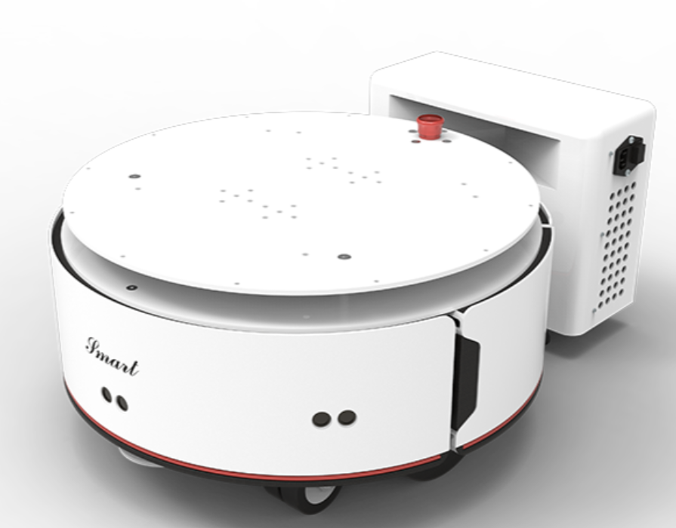
Mini Challenge 3
Introduction
This mini-challenge is intended for the student to review the concepts introduced in the previous sessions.
The robot to be used in the following sessions by the students are the EAI Smart Robots.
The robot contains several ultrasonic sensor modules.
Such sensors are typically used for obstacle avoidance or other “reactive” navigation techniques.

Slide 3
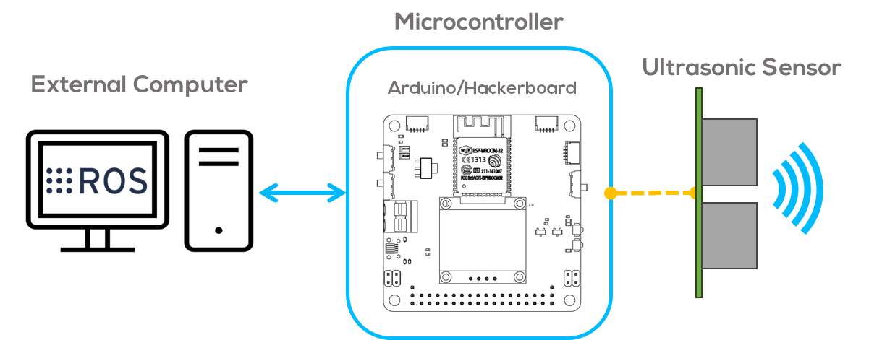
Mini Challenge 3
Introduction
These sensors are typically connected to low-level control devices in a master-slave architecture, such as microcontrollers or other embedded solutions; to save processing time and allow the computer to focus on more complex tasks.
The activity involves creating a ROS node to communicate an ultrasonic sensor with the computer using ROS.
The sensor will be read using a microcontroller (Arduino Board) as an intermediary to save the computer's processing time.
See the following slides for requirements.

Slide 4
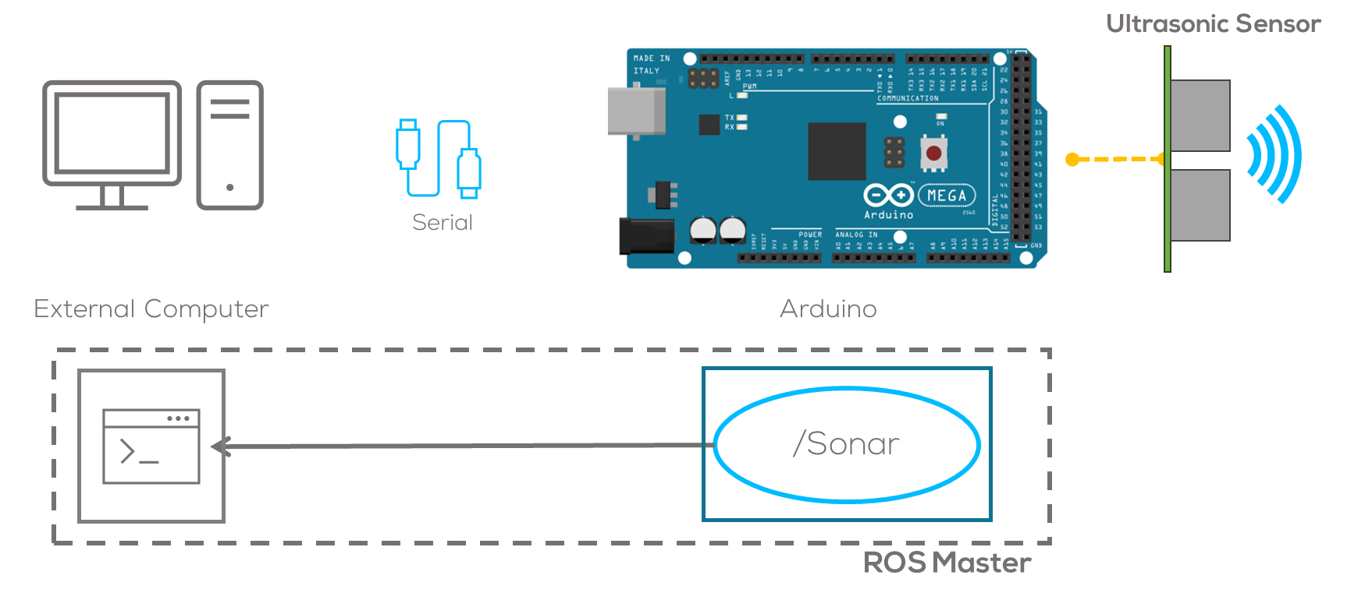
Mini Challenge 3
Challenge
The student must be able to visualize the data provided by an ultrasonic sensor using ROS.
To do this, the student must program a node that publishes the data obtained by the microcontroller from the ultrasonic sensor.
Connect a sonar to the Arduino module and publish the data range of the sonar using ROS.
The student must develop the communication libraries for the communication between the sonar and the Arduino. More information about the manufacturer’s protocol here.
The communication must be performed via serial, using the rosserial library for Arduino.

Slide 5
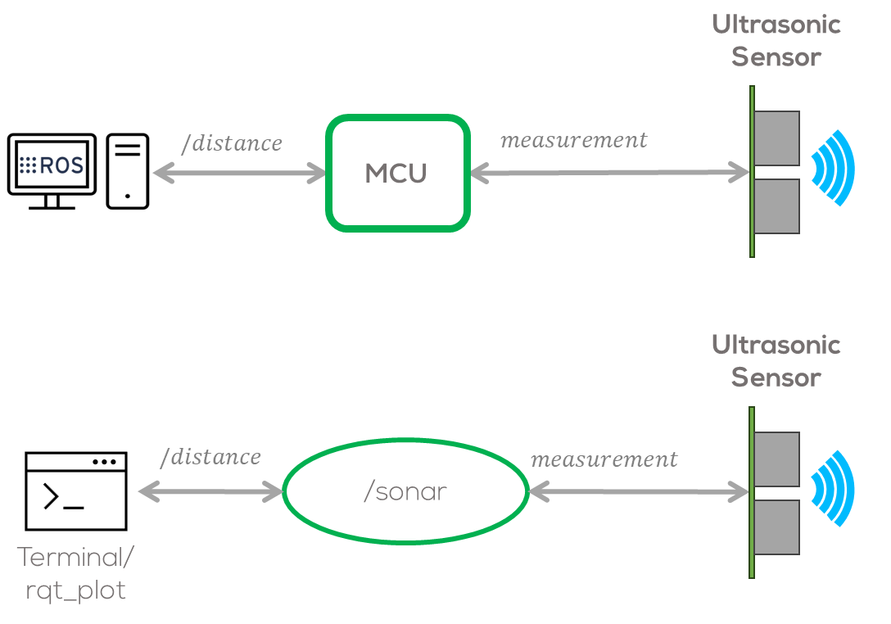
Mini Challenge 3
Challenge
The information from the sensor must be published using the topic “/distance”
The measurement must be published using a Float32 message.
The result must be plotted using any visualizer available such as: “rqt_plot”.
The nodes and topics must be visualized using the “rqt_graph”.

Slide 6
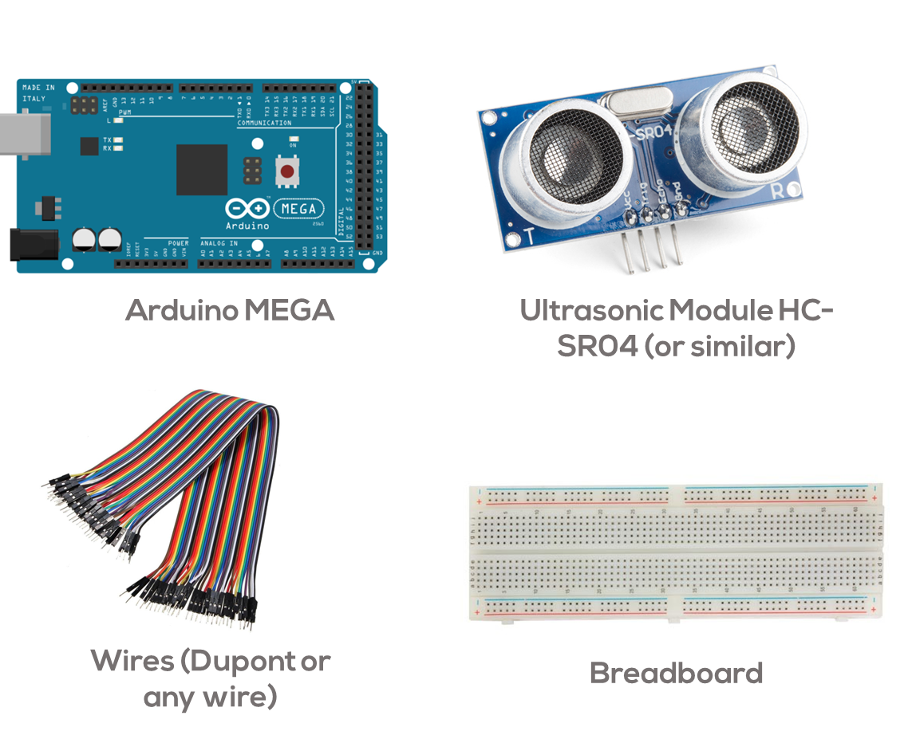
Mini Challenge 3: Requirements

Slide 7
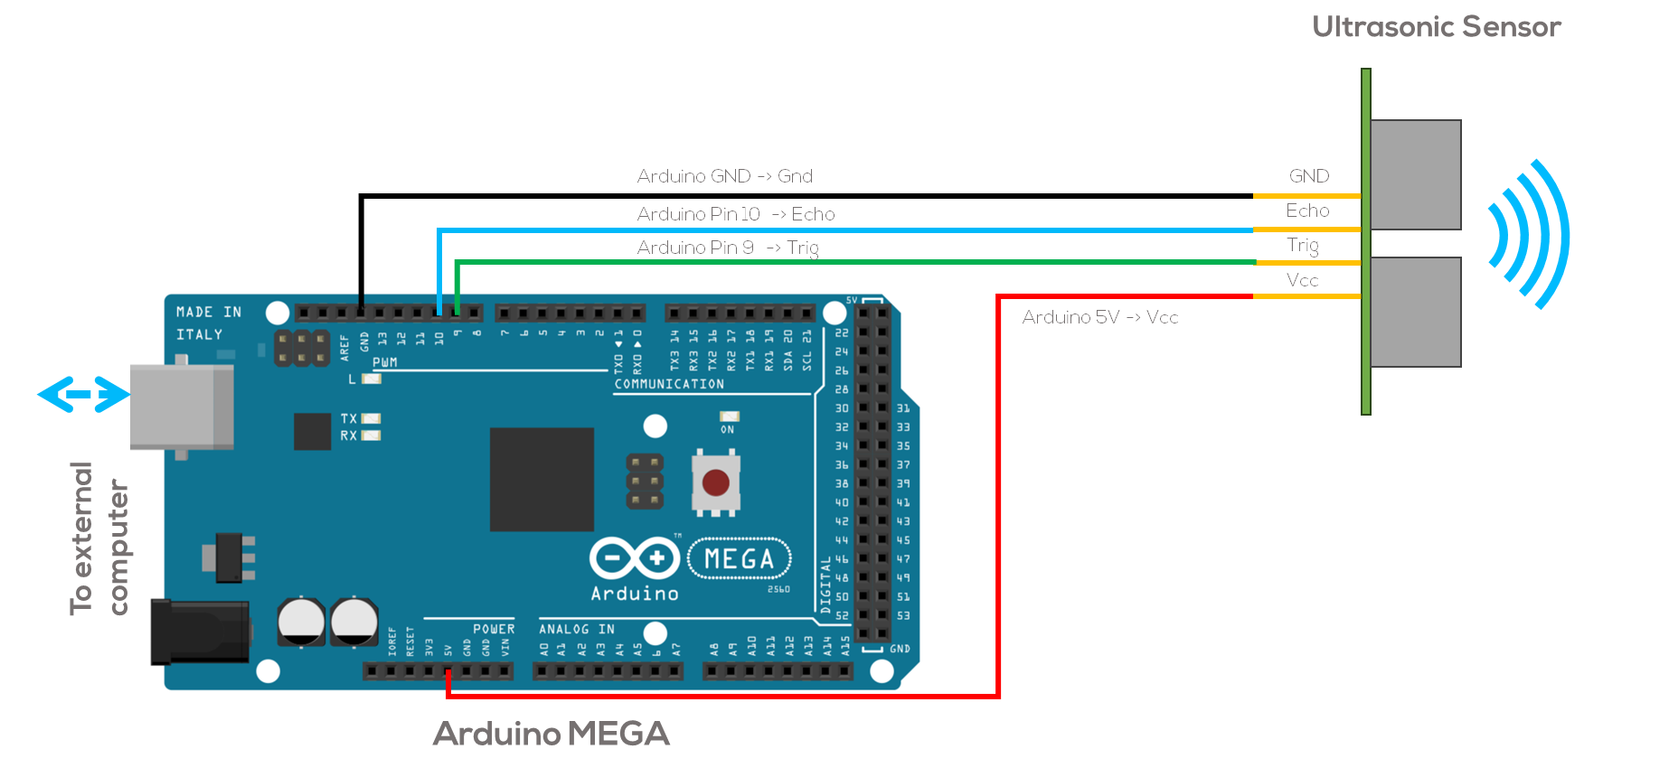
Mini Challenge 3: Connection Diagrams

Slide 8
Deliverables
REPORT
Maximum number of pages: 2 pages, not including presentation.
Presentation: Include name, student ID, and team name.
Minimum font size: 11 pt.
Appendix: No.
Report type: Individual.
Report design: Single-column or two columns.
Format: PDF
Content Details:
Each task must be included in a different section.
It is recommended to use diagrams, figures, tables, etc.
Include reflections, conclusions, y recommendations of each result in detail.
Include references using the IEEE format.
Important: Results and/or figures that do not contain information or detailed explanations will be penalized.
Teams:
The students must form teams for this mini-challenge. The teams will be the same as in other classes of this concentration.
Th teams must be multidisciplinary.
The students must respectfully help each other to understand all the topics.
The team must manage the project, using a project management methodology, and present it in the report.
The methodology selected can be simple, E.g., Waterfall, Agile, Kanban, etc.

Slide 9
Deliverables
Rubric
Introduction
Explain the problem and why is essential.
Explain the project management strategy selected (use diagrams, flow chart)
The student must show diagrams explaining how the project management strategy was implemented.
The student must describe concretely, why this strategy was selected.
Explain the code, and how it works? Constraints? Advantages, and disadvantages? etc. )
The student must explain the code using diagrams, flowcharts, etc.
The student must show the proposed solutions' constraints, advantages, and disadvantages.
Plots used to verify and analyse the behaviour of the algorithms, showing the performance of the sensor
The student must show the plots used to verify the behaviour of the algorithm estimated robot position over time, control input, etc.
Reflect on the sensor’s performance and propose solutions (What problems can be expected? Solutions/improvements?)
The student must provide a small reflection on the problems that can occur using their algorithm with ROS.
The student is expected to explain the physical phenomena that make obtaining measurements difficult, if applicable.
The student must propose some solutions on how to solve these issues.
Report presentation, references, and clarity
Report must be clear for the reader, well organised, and with a good presentation and references.

Slide 10


Mini Challenge 3: Extension 1 (extra marks, not mandatory)
Be creative!
Generate a node on the computer that subscribes to the “/distance” topic and use the information of the sensor to perform a simple task in ROS, e.g., Distance alarm, parking sensor, etc.
Must be implemented using ROS.
The report must clearly define and describe the task (1/2 a page to 1 page maximum added to the report).
Usage of diagrams, images flowcharts is encouraged.
A video (YouTube) showing how it works must be presented.

Slide 11
Mini Challenge 3: Extension 2 (not mandatory, no extra marks)
Challenge Extension 2
Publish the measurement using an appropriate standardized message for range measurements in ROS.
“Range” is the typical standard message in the “sensor_msgs” library. More information here.
Hint 1: call the library on the Arduino as follows “#include <sensor_msgs/Range.h>”
Hint 2: Do not forget the time stamp of the message, you can define it as follows,
“message_name.header.stamp = nh.now();”
Where nh.now() is the ROS time inside the library
“#include <ros/time.h>”
The results of this task must be included in the report in less than 1/2 page.

Slide 12
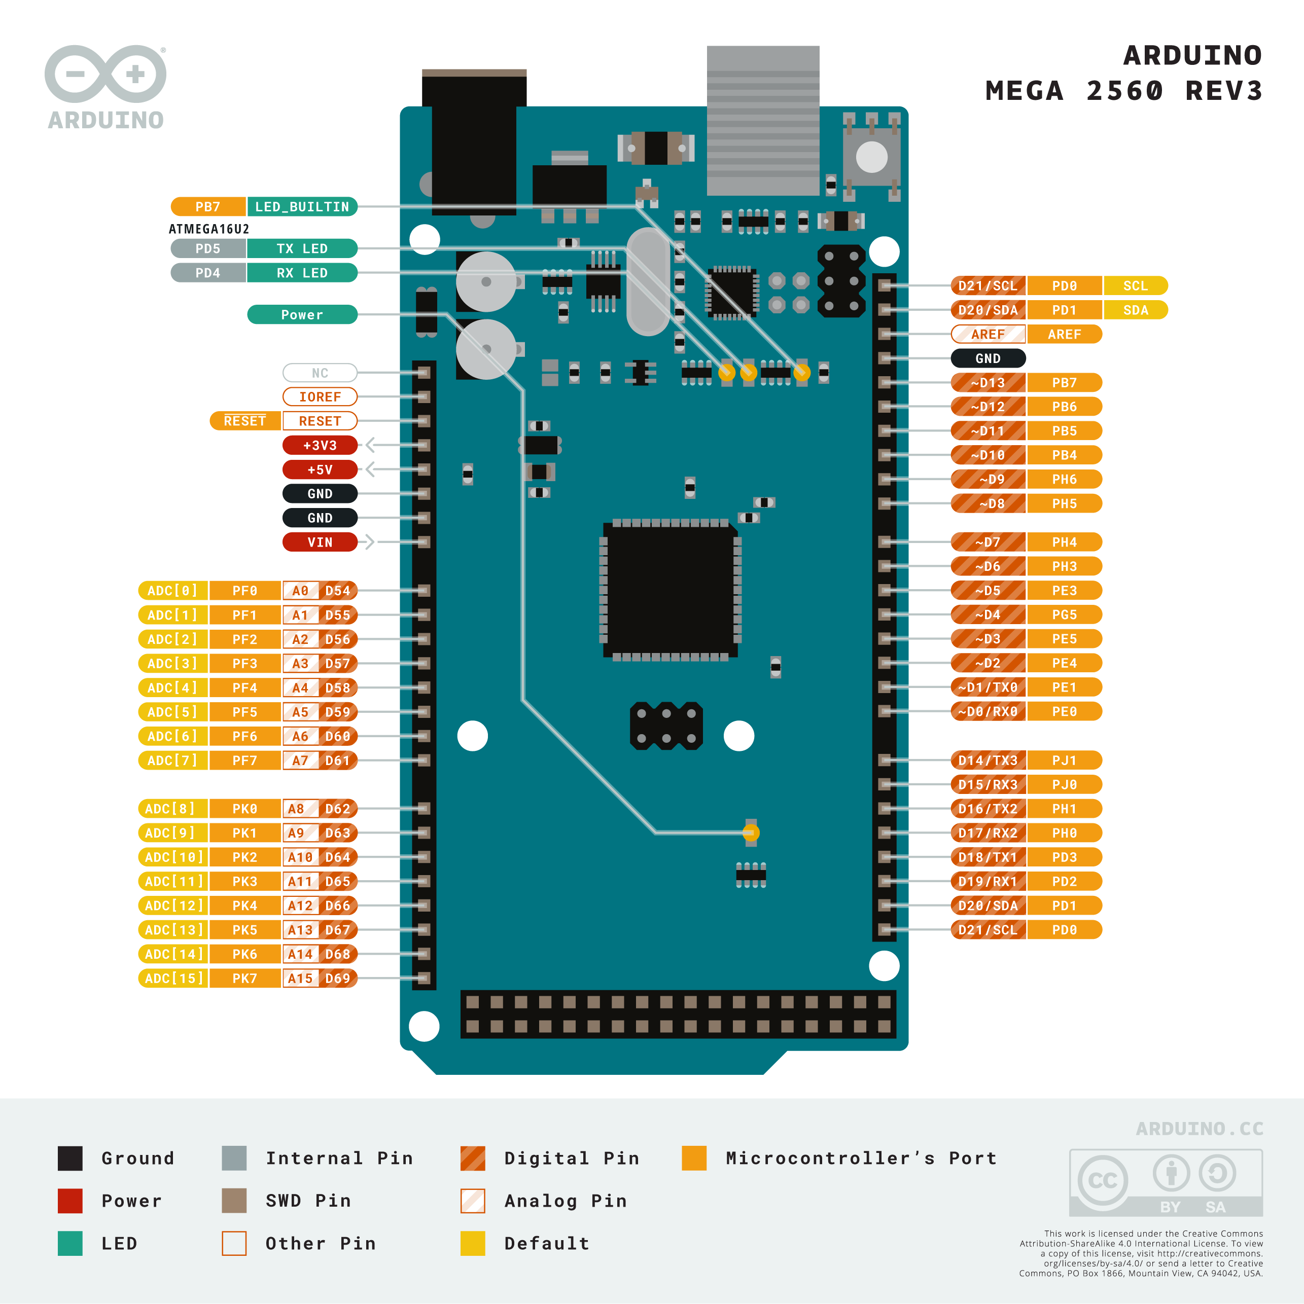

Slide 13
Rules
This is challenge, not a class. The students are encouraged to research, improve tune explain their algorithms by themselves.
MCR2(Manchester Robotics) Reserves the right to answer a question if it is determined that the question contains partially or an answer.
The students are welcome to ask only about the theoretical aspect of the class.
No remote control or any other form of human interaction with the simulator or ROS is allowed (except at the start when launching the files).
It is forbidden to use any other internet libraries except for standard libraries such as NumPy.
If in doubt about libraries, please ask any teaching assistant.
Improvements to the algorithms are encouraged and may be used if the students provide the reasons and a detailed explanation of the improvements.
All the students must respect each other and abide by the previously defined rules.
Manchester Robotics reserves the right to provide any form of grading. Grading and grading methodology are done by the professor in charge of the unit.

